Slide 1
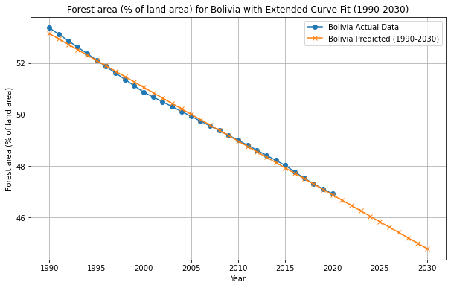
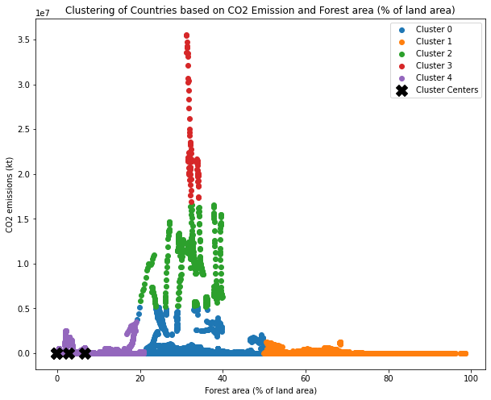
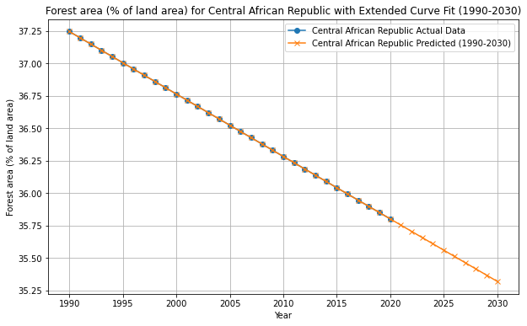
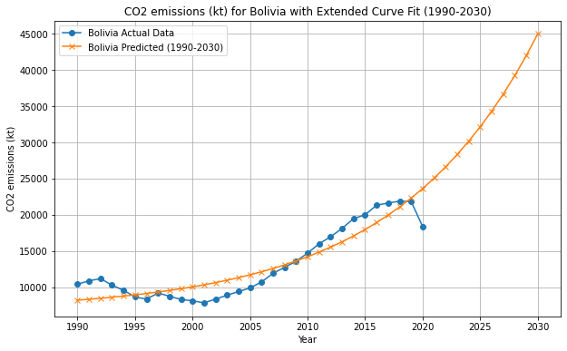
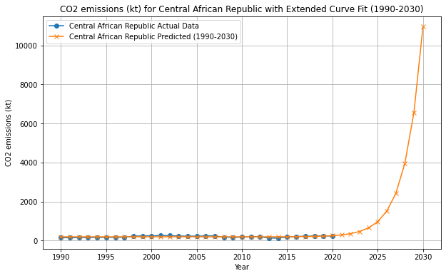





Environmental Trends and Projections:
BOLIVIA And Central African Republic (1990-2030)
Name: Mohammed Nihad Kaipalli
Student ID: 22081746
An Insightful Analysis of Deforestation and Carbon Emissions
Abstract
The provided graphs illustrate the CO2 emissions trends for the Central African Republic and Bolivia spanning the years 1990 to 2030. These graphs present a comprehensive view, including both actual data and predicted values.
Bolivia exhibits a gradual rise in actual emissions to approximately 20,000 kt by 2020, with predictions diverging thereafter, foreseeing just under 45,000 kt by 2030. In the Central African Republic, actual emissions remain consistently low, contrasting with a sharp predicted increase post-2020 to around 10,000 kt by 2030.
Both graphs suggest a notable surge in CO2 emissions by 2030 if predictive models prove accurate, particularly concerning for the Central African Republic. These models are crucial tools for policymakers and environmentalists addressing climate change impacts.
This poster conducts a comprehensive analysis of CO2 emissions and forest area data for various countries. It incorporates data cleaning techniques, KMeans clustering, and curve fitting to gain insights into the relationship between forest area and CO2 emissions. It reads and cleans CO2 emissions and forest area datasets, merges them, and performs KMeans clustering, with silhouette scores calculated for evaluation. Visualizations of clustered countries based on forest area and CO2 emissions are generated. Additionally, the script conducts curve fitting and prediction for specific countries, showcasing both historical and predicted trends for CO2 emissions and forest area. Overall, the script provides a structured approach to analyze environmental data and visualize patterns through clustering and curve fitting techniques.
Clustering of Countries by CO2 Emissions and Forest Area
Forest Area Trends in Bolivia and Central African Republic (1990-2030)
The Scatter plot is being used for clustering analysis, comparing countries based on two variables: "Forest area (% of land area)" on the x-axis and "CO2 emissions (kt)" on the y-axis. Each dot represents a country, and the dots are colored and grouped into five different clusters (0 to 4), presumably based on similarities in their forest area and CO2 emissions data. The clustering might have been performed using an algorithm like k-means, indicated by the presence of "Cluster Centers" marked with stars, which represent the central point or the "mean" of each cluster. Additionally, the Silhouette Score is also calculated for 5 clusters: 0.5603660915040879.
CO2 Emissions Trends in Bolivia and Central African Republic (1990-2030)
Two graphs depicting the forest area percentage trends for the Central African Republic and Bolivia from 1990 to 2030. Both graphs feature actual recorded data (blue line) and extrapolated predictions (orange line) showing a consistent downward trend in forest area percentage. The layouts are similar, with x-axis representing years and y-axis representing the percentage of land area covered by forests.
The data points on both graphs are closely aligned with the extended curve fit lines, suggesting a consistent trend over the years. The predictions suggest a continuing decline in forest area for both countries.
Conclusion
In summary, the provided analysis offers a comprehensive examination of CO2 emissions and forest area data for various countries, employing data cleaning, KMeans clustering, and curve fitting techniques. The clustering analysis, depicted through scatter plots, highlights similarities in forest area and CO2 emissions among countries, aiding in the identification of distinct clusters.
The subsequent focus on CO2 emissions trends for the Central African Republic and Bolivia reveals a concerning surge in predicted emissions by 2030, particularly for the former.
The parallel examination of forest area percentage trends for both countries further underscores a consistent downward trajectory, emphasizing the environmental challenges they face.
Overall, these analytical tools and visualizations serve as valuable resources for policymakers and environmentalists, offering insights into the complex relationship between forest cover and carbon emissions, crucial for addressing the impacts of climate change.

